Slide 1
Faircloth-to-RAD Development Proposal
Paces Preservation Partners

Slide 2
Faircloth-to-RAD
The 1998 Faircloth Amendment: a Limit of 2,356 public housing units to be owned and operated by HAS
681 units converted to RAD, 918 still active
Current Faircloth Authority enabling HAS to develop additional 757 public housing units in Savannah
Rental Assistance Demonstration program authorizing the conversion of public housing units to Section 8, hence allowing PHAs to leverage public and private debt and equity to preserve / improve units
Long term Section 8 contract ensures continuous affordability
Annual rent adjustments (OCAF)
Resident protection

Slide 3
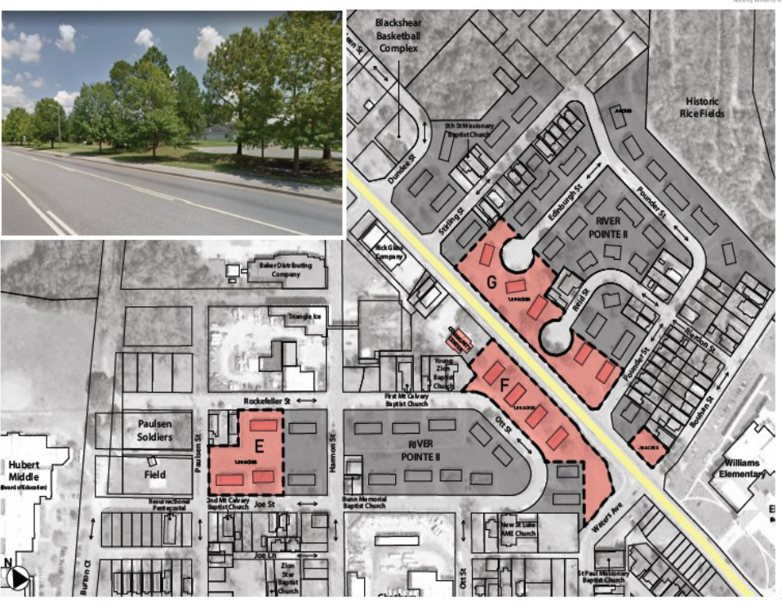
Blackshear Homes footprint
(still under DOT)

Slide 4
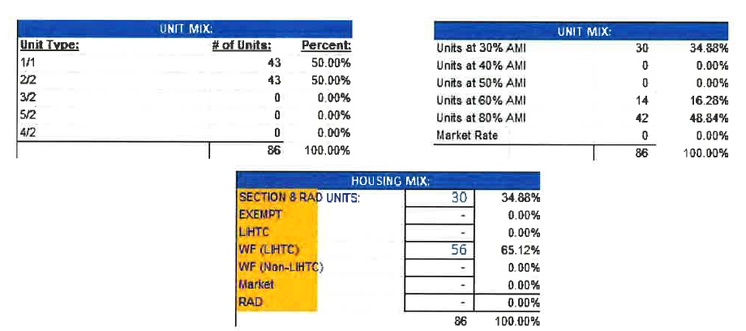
Proposal by Paces Preservation Partners:
Development of a senior property with 86 units of one and two bedrooms, among which 30 units would be Faircloth-to-RAD units receiving HAS assistance through Project-Based Vouchers (PBVs)

Slide 5
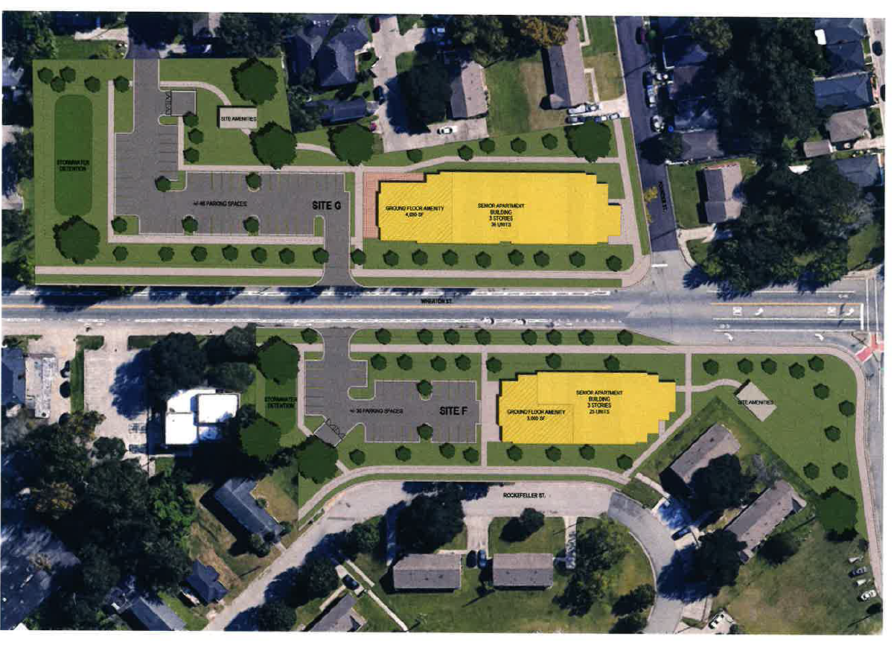
Preliminary site Plan: vacant parcels on Wheaton Street

Slide 6
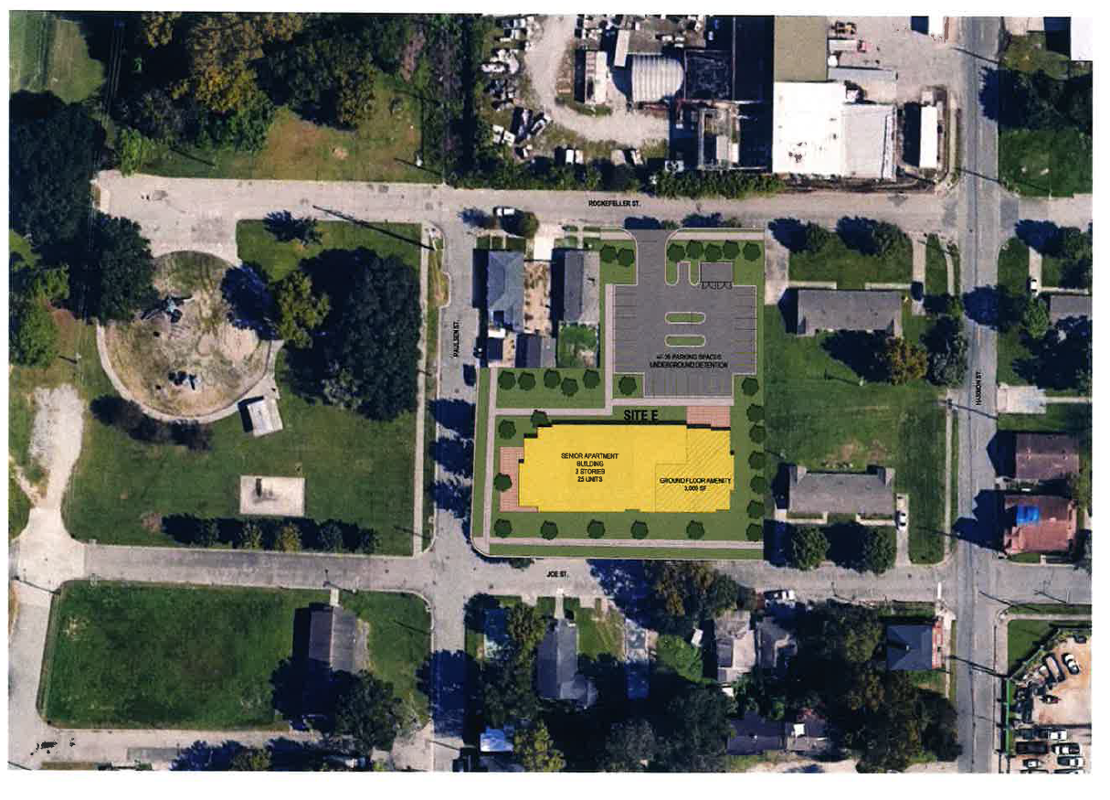
Preliminary site Plan: vacant parcel between Joe and Rockefeller Streets

Slide 7
Preliminary Development Budget
Sources of Funds
9% Low-Income Housing Tax Credits | $19,978,002
Permanent Loan | $6,900,000
Total Sources | $26,878,002
Use of Funds
Hard Construction Costs | $18,882,504
Soft Costs (A&E, Legal, Fees, Marketing) | $5,915,498
Developer Fee | $2,079,000
HAS Ground Lease | $1,000
Total Use of Funds | $26,878,002
$312K / unit

Slide 8
Preliminary Rent Schedule
Unit Type | Percent of Median | Number of Units | Gross Sq. Ft. | Gross Rent
RAD 1 BDRM | 30% AMI | 15 | 906 | $520
LIHTC 1 BDRM | 60% AMI | 7 | 906 | $1,040
LIHTC 1 BDRM | 80% AMI | 21 | 906 | $1,387
RAD 2 BDRMs | 30% AMI | 15 | 1217 | $624
LIHTC 2 BDRMs | 60% AMI | 7 | 1217 | $1,248
LIHTC 2 BDRMs | 80% AMI | 21 | 1217 | $1,664

Slide 9
Preliminary Development Schedule
Initiate negotiation with Paces Preservation Partner | December 2024
Development Agreement for Board approval | February 2024
LIHTC submission to the State Department of Community Affairs (DCA) | May 2025
LIHTC Award | October 2025
Pre-Development Phase | Oct 2025 – Aug 2026
Financial Closing | September 2026
Construction Completion and RAD Closing | December 2027

