Slide 1

Hotel Development Overlay Expansion Study
Metropolitan Planning Commission
August 26, 2025

Slide 2
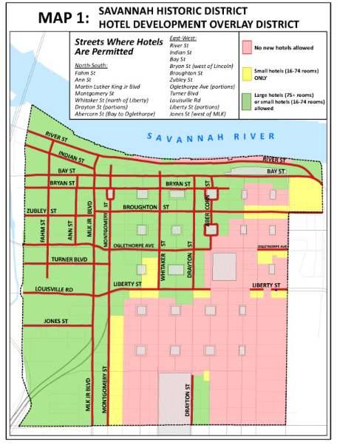
Current Hotel Development Overlay District
Applies to Savannah Historic District (Article 7 Sec. 7.13)
Distinguishes hotel categories:
Large hotels (75+ guest rooms)
Small hotels (16-74 guest rooms)
New hotels permitted only within certain areas based on size and street designation
New hotels must front a designated street

Slide 3
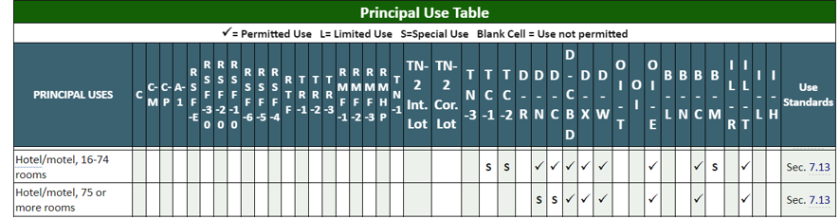
Current zoning for hotel development
Principal Use Table (Sec. 5.4)

Slide 4
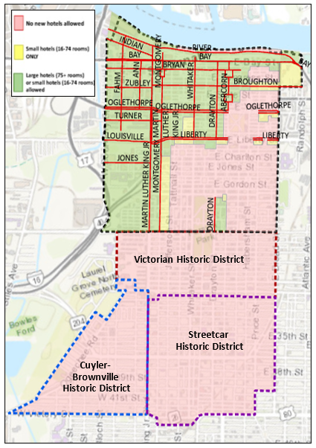
Petition from these neighborhoods for no hotels:
Cuyler Brownville
Streetcar
Victorian
Proposal to expand HDO to:
Prevent negatively impact to neighborhood quality of life
Help maintain affordability
Encourage in-fill
Provide public review
Stakeholders requested broader engagement and collaboration:
Savanah Area Chamber of Commerce
Savannah Downtown Business Association
Savannah Economic Development Authority
Tourism Leadership Council

Slide 5
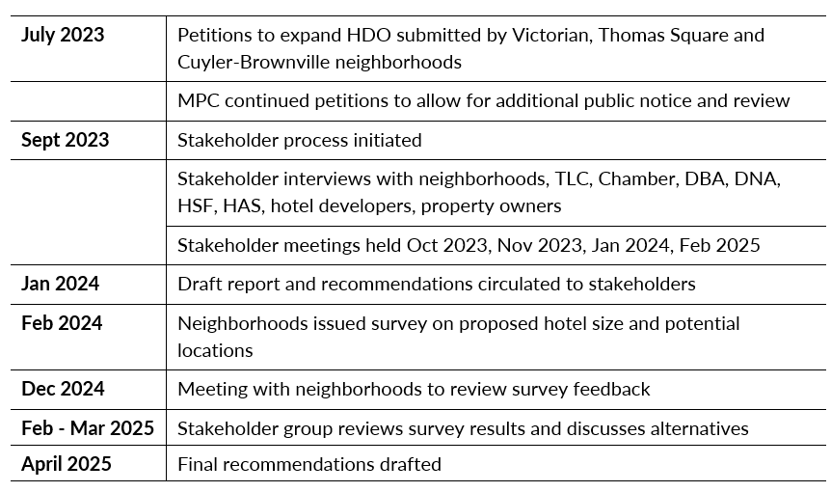
HDO Expansion Stakeholder Process

Slide 6
Current zoning for hotel development in 3 neighborhoods:
In TC-1 and TC-2 Traditional Commercial zoning districts:
Small hotels (16-74 rooms) permitted only when approved in accordance with Sec. 3.10, Special Use Permit
No use standards currently exist for hotel use
Large hotels are not permitted in TC zoning districts

Slide 7
No use standards under 8.4.36
Current development standards for hotel development
All new hotel developments must also comply with:
Development Standards for Permitted Uses
General Site Standards
Local Historic Overlay District Standards (Savannah Downtown, Streetcar, Victorian, Cuyler-Brownville Historic Districts)

Slide 8
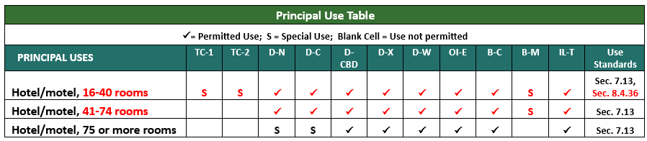
Considerations
Revise hotel size definitions
Change Principal Use Table
Add possible use conditions for small hotels in TC-1 and TC-2 zoning districts
Possible amendments to Principal Use Table with new definitions of small and mid-size hotels:

Slide 9
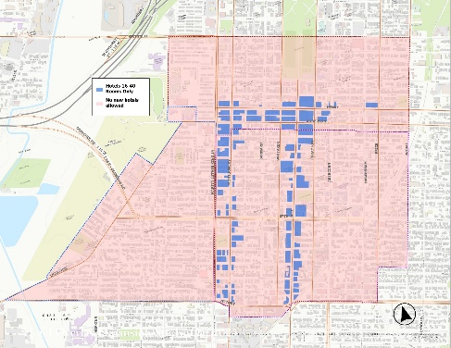
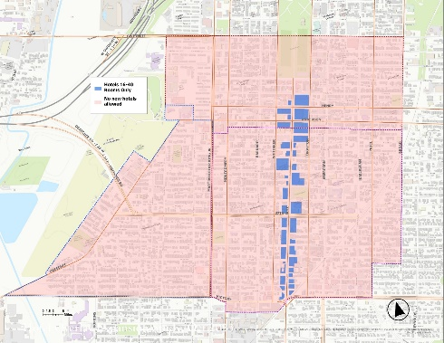
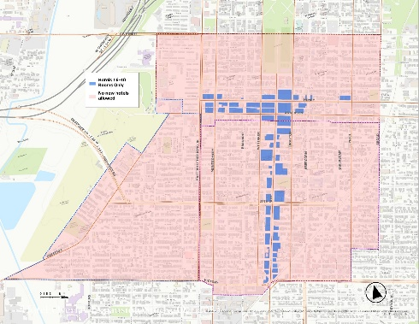
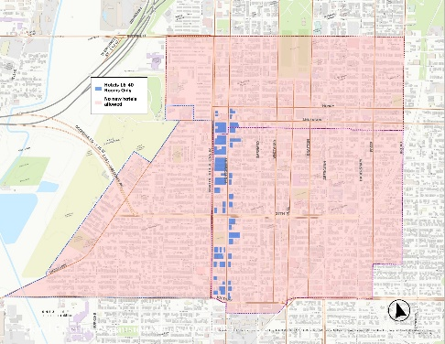
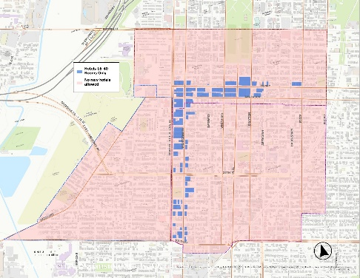

Examined TC- zoned parcels
Considered an expanded Hotel Overlay
5 different scenarios
Scenario 1: Bull, Henry-Anderson, MLK-Montgomery
Scenario 2: Bull Street
Scenario 3: Bull, Henry-Anderson
Scenario 4: MLK-Montgomery
Scenario 5: MLK-Montgomery, Henry-Anderson

Slide 10
Initial Stakeholder Recommendations
Consider smaller hotel size (16-40 rooms) that could potentially be permitted in TC zoning districts within expanded hotel development overlay.
Consider designated locations or corridors where a smaller hotel use could potentially be permitted within expanded hotel development overlay.
Consider amendments to commercial use standards for hotel/motel use to reduce impacts of hotel development on neighborhoods (Sec. 8.4.36).

Slide 11
Possible Use Standards for Hotel/Motel Use
Within any TC-1 and TC-2 district:
Use shall front an arterial
Onsite staff 24 hours, 7 days/week
Screening and buffering as required; no reductions permitted
Design standards for mechanical equipment and refuse as required; no reductions permitted
Outdoor pool access by hotel guests only
Building footprint not to exceed maximum allowed

Slide 12
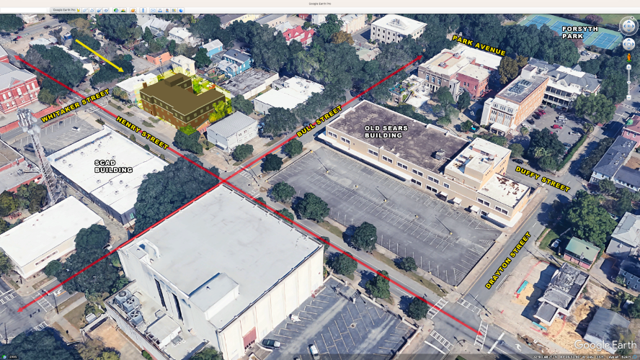
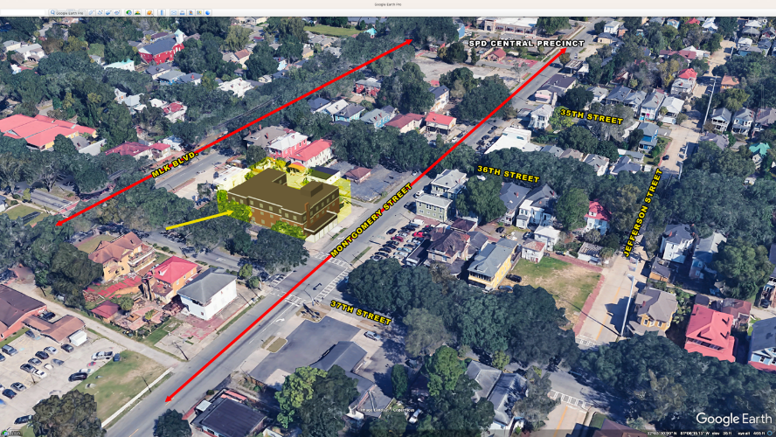
Neighborhood Survey
Issued by 3 neighborhoods to gauge support for 40-room hotel size and designated location scenarios
More than 700 responses from residents, businesses, and interested stakeholders
Responses showed widespread opposition to smaller-scaled hotel example
Two of four scenarios of 40-room hotel locations provided in survey

Slide 13
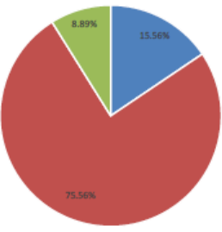
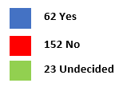
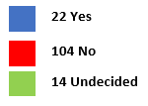
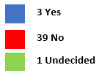
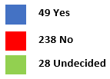
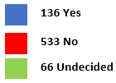
Neighborhood Survey Results
General Support for 40-room hotels by Neighborhood
Thomas Square / Starland
Other Respondents
All Respondents
Victorian
Cuyler-Brownville

Slide 14
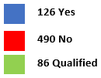
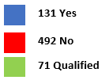
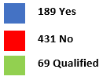
Neighborhood Survey Results
Support by Corridor – All Respondents
Bull Street (702)
Henry-Anderson (694)
MLK-Montgomery (689)

Slide 15
Neighborhood Survey Results
Nature of Opposition
Impact on community character
Quality of life concerns
Preference for housing over hotels
Economic and social equity
Desire for community-focused development
Government and developer accountability
Nature of Qualified Support
Economic benefits and revitalization
Controlled and strategic development
Enhanced services and amenities

Slide 16

Stakeholder Discussions
Neighborhoods
Based on neighborhood survey feedback, move forward with original petition to expand HDO with no new hotels allowed.
Hotel Industry
Consider smaller hotel size (16-40 rooms) that could potentially be permitted in TC zoning districts within expanded HDO.
Consider designated locations or corridors where a smaller hotel use could potentially be permitted within expanded HDO.
Consider amendments to commercial use standards to reduce impacts of hotel development on neighborhoods.

Slide 17
Stakeholder Discussions
Other options for discussion/agreement:
Hotel use keeps Special Use review currently in zoning ordinance
Add special use and public review requirements
Smaller than 40-room “small” hotel definition (e.g., 25-30 rooms)
Restrict hotel use to specific street sections

Slide 18
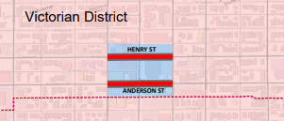
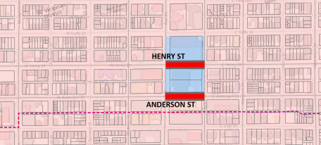
Stakeholder Discussions
Restrict hotel use to specific street sections:
Properties facing Henry and Anderson between Drayton and Whitaker (former Sears Building and parking lot, BellSouth/AT&T Building, St. Paul’s Greek Orthodox Church, Bull Street Baptist, and SCAD)
Two parcels along Henry and Anderson between Drayton and Bull (former Sears Building and parking lot, BellSouth/AT&T Building)

Slide 19
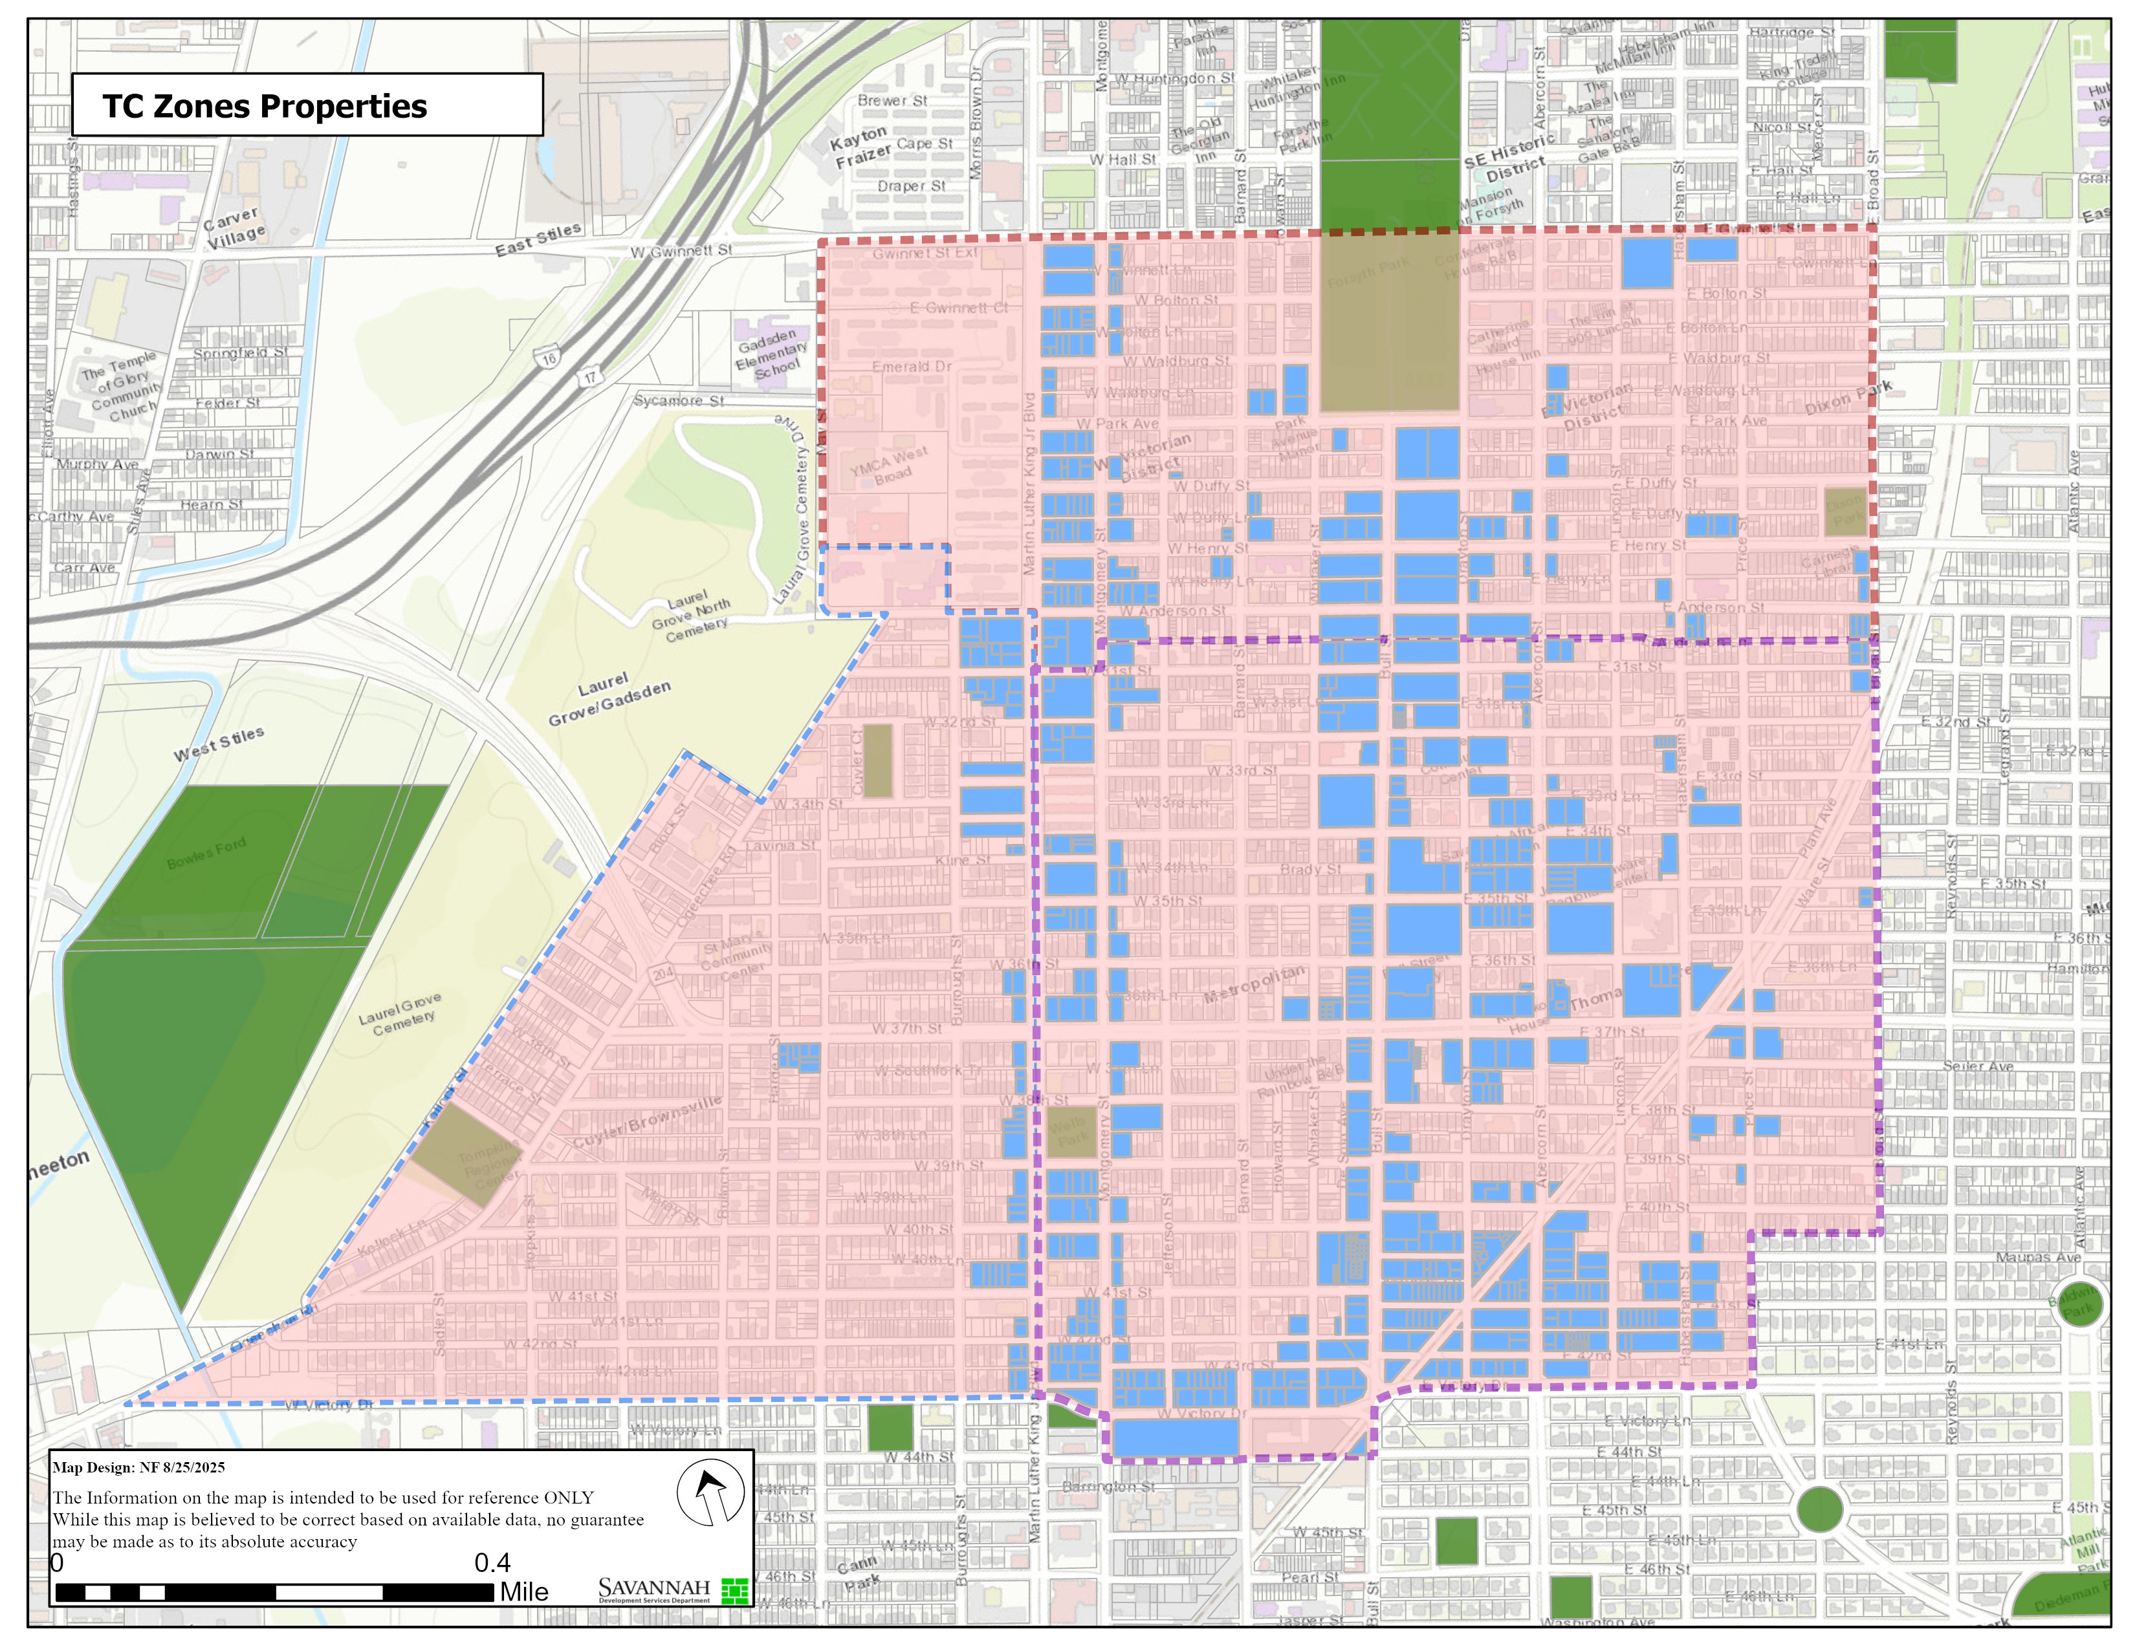
Recommendation Option 1
Within the expanded HDO, hotels with 40 rooms or less would be permitted as a Special Use in all TC-1 and TC-2 (Traditional Commercial) districts

Slide 20
Recommendation Option 2
Within the expanded HDO, hotels with 40 rooms or less would be permitted as a Special Use in designated areas limited to properties facing Anderson and Henry streets between Whitaker and Drayton streets
All of these parcels are zoned TC-2, except for one parcel zoned TC-1

Slide 21
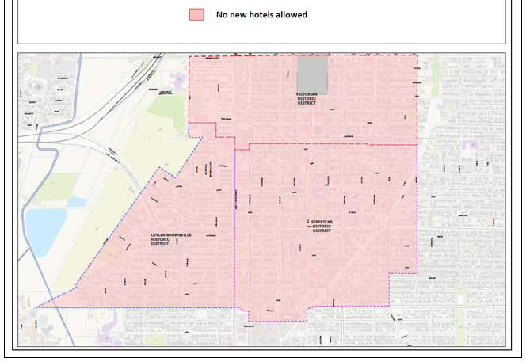
Recommendation Option 3
Within the expanded HDO, no hotels permitted

Slide 22
Recommendation 2
Sec. 8.4.36. Within any TC (Traditional Commercial) districts, the following standards apply to the hotel/motel use:
Such use shall be limited in size to 16 to 40 rooms.
Such use shall be part of a mixed-use development.
Such use must provide 24 hours, 7 days a week onsite staff to assist guests with lodging services.
Reductions in screening and buffering as required by Sec. 9.5 shall not be varied.
Reductions in design standards for mechanical equipment and refuse as required by Sec. 7.9.10, 7.10.10, and 7.11.10 shall not be varied.
The developer shall submit to the Jurisdiction an affidavit stating that any outdoor pool proposed as part of the hotel development shall be accessed by hotel guests only.
The building footprint of a proposed hotel development may not exceed the maximum allowed by Sec. 5.13.5, Development Standards for Permitted Uses, and shall not be varied.

Slide 23
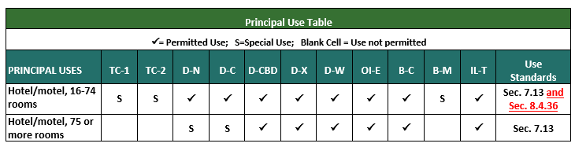
Recommendation 3
Amend Sec. 5.4 Principal Use Table to include reference to proposed use standards for hotel use.

Slide 24
Next Steps
Planning Commission discussion
Present as a text and map amendment to Planning Commission
Forward recommendation to City Council for consideration

